Slide 1
Comparison between local binary CNN and vanilla CNN
Jianhao Peng, Hanchao Yu, You Wu
jianhao2@illinois.edu,
hanchao2@illinois.edu,
youw3@illinois.edu

Slide 2
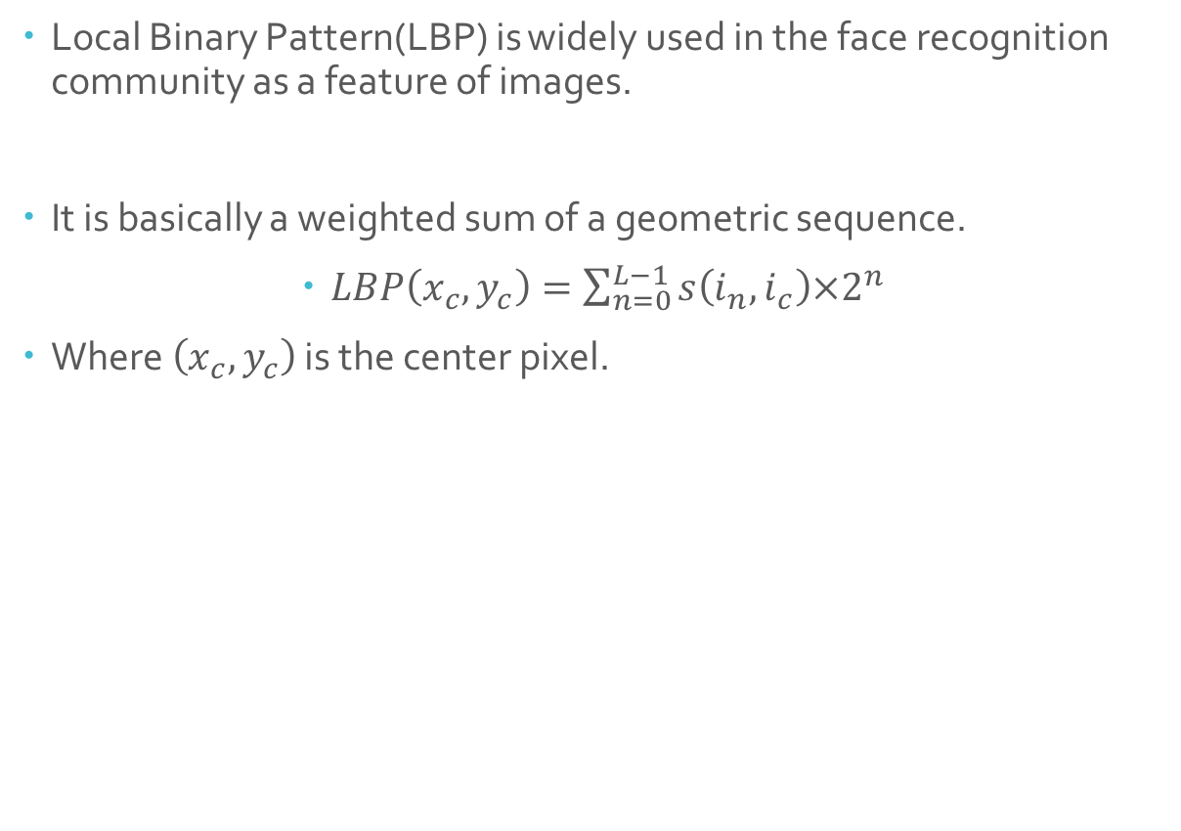
Background Knowledge
Local Binary Pattern(LBP) is widely used in the face recognition community as a feature of images.
It is basically a weighted sum of a geometric sequence.
$LBP\left(x_{c}, y_{c}\right)=\sum_{n=0}^{L−1}{s\left(i_{n}, i_{c}\right)×2^{n}}$
Where $\left(x_{c}, y_{c}\right)$ is the center pixel.
*pictures from tensorflow.org

Slide 3
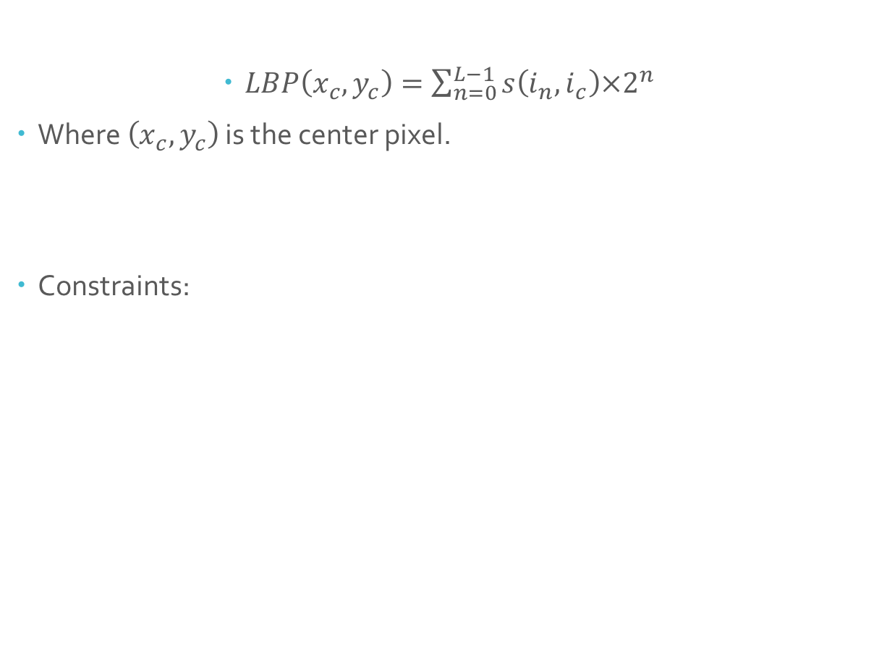
Background Knowledge
$LBP\left(x_{c}, y_{c}\right)=\sum_{n=0}^{L−1}{s\left(i_{n}, i_{c}\right)×2^{n}}$
Where $\left(x_{c}, y_{c}\right)$ is the center pixel.
Constraints:
*pictures from tensorflow.org

Slide 4
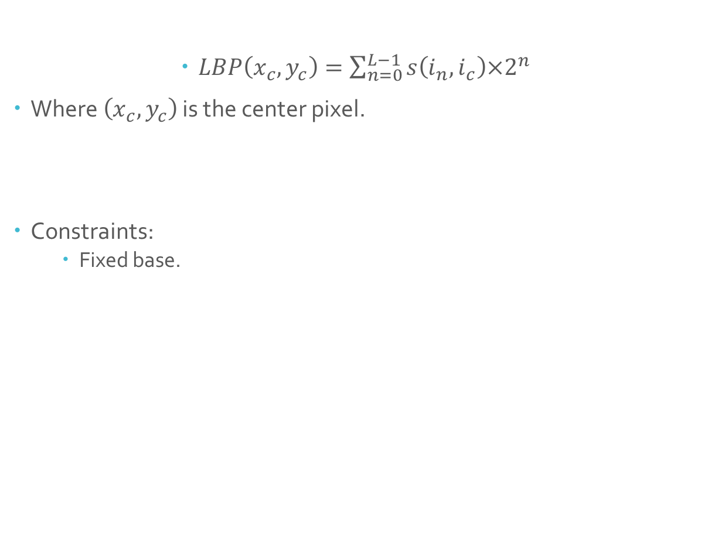
Background Knowledge
$LBP\left(x_{c}, y_{c}\right)=\sum_{n=0}^{L−1}{s\left(i_{n}, i_{c}\right)×2^{n}}$
Where $\left(x_{c}, y_{c}\right)$ is the center pixel.
Constraints:
Fixed base.
*pictures from tensorflow.org

Slide 5
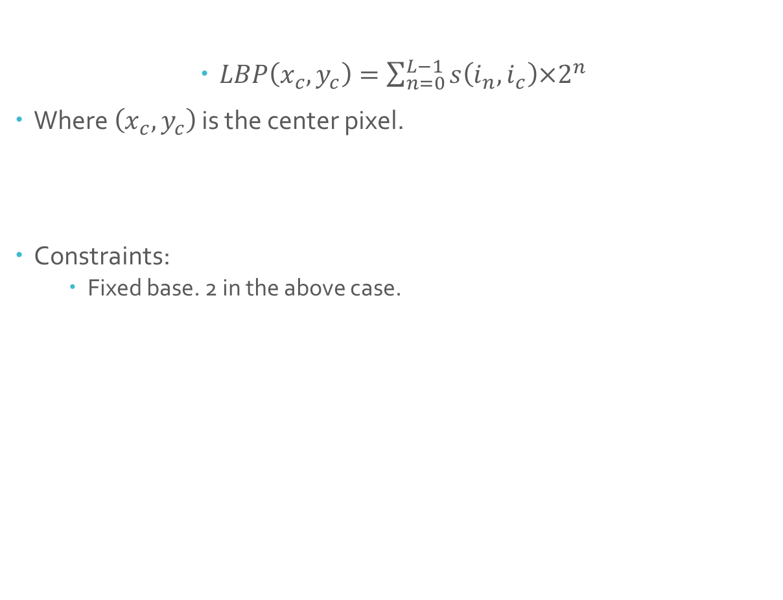
Background Knowledge
$LBP\left(x_{c}, y_{c}\right)=\sum_{n=0}^{L−1}{s\left(i_{n}, i_{c}\right)×2^{n}}$
Where $\left(x_{c}, y_{c}\right)$ is the center pixel.
Constraints:
Fixed base. 2 in the above case.
*pictures from tensorflow.org

Slide 6
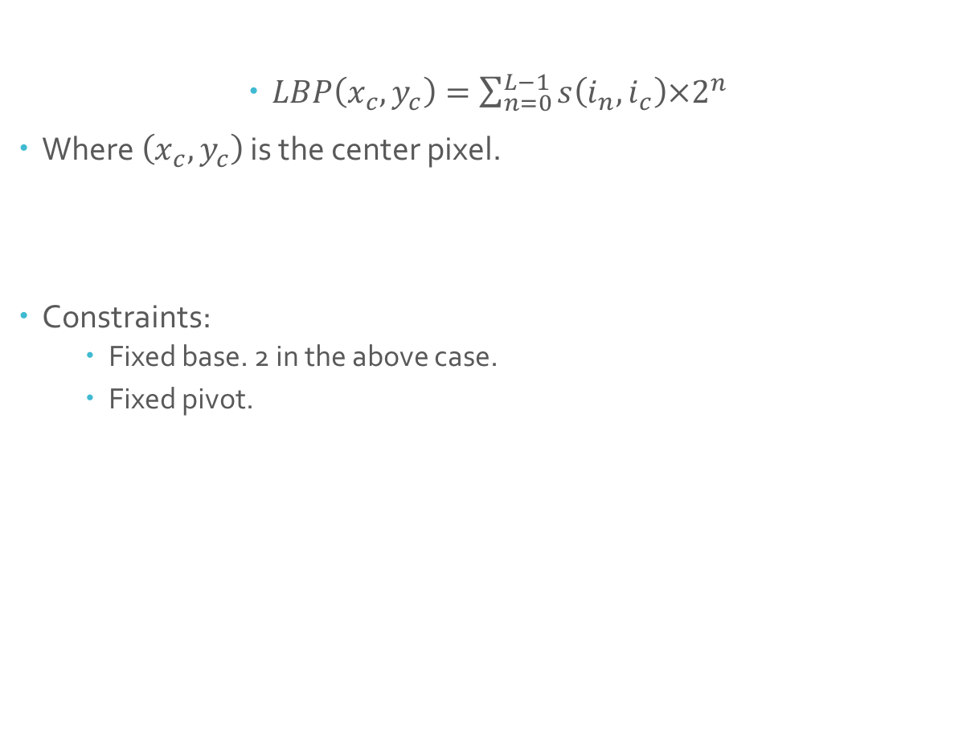
Background Knowledge
$LBP\left(x_{c}, y_{c}\right)=\sum_{n=0}^{L−1}{s\left(i_{n}, i_{c}\right)×2^{n}}$
Where $\left(x_{c}, y_{c}\right)$ is the center pixel.
Constraints:
Fixed base. 2 in the above case.
Fixed pivot.
*pictures from tensorflow.org

Slide 7
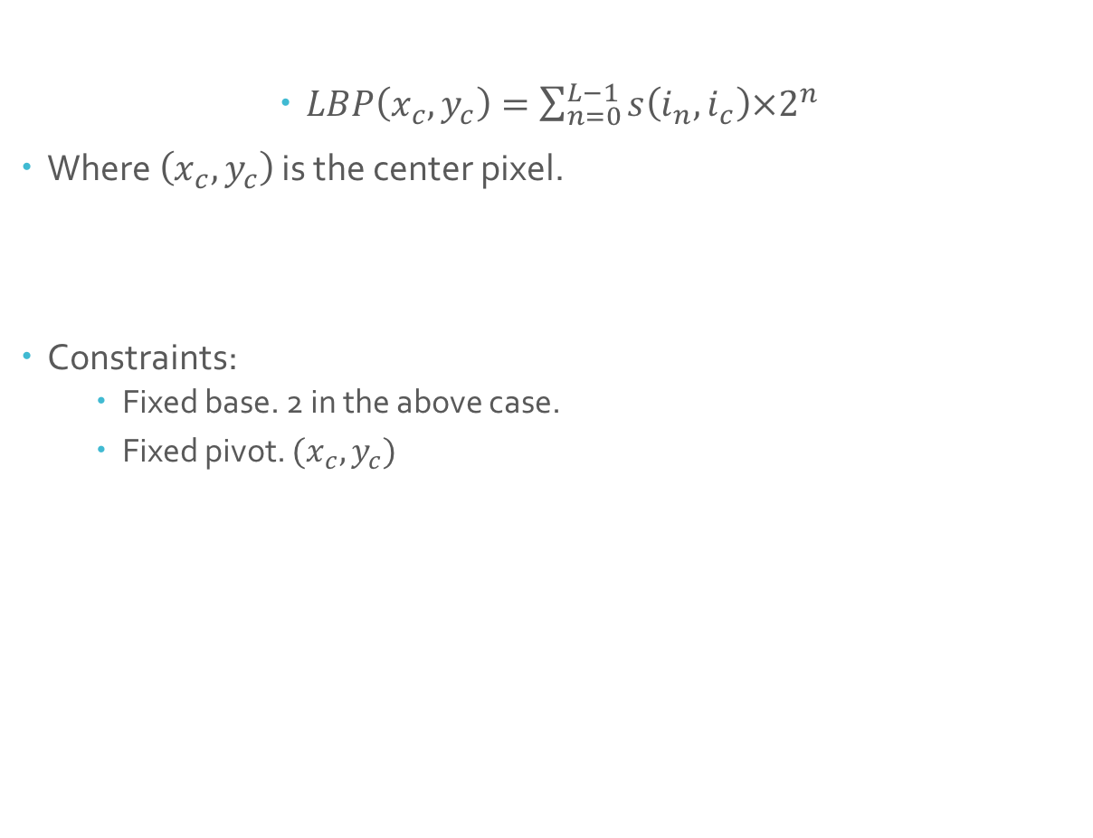
Background Knowledge
$LBP\left(x_{c}, y_{c}\right)=\sum_{n=0}^{L−1}{s\left(i_{n}, i_{c}\right)×2^{n}}$
Where $\left(x_{c}, y_{c}\right)$ is the center pixel.
Constraints:
Fixed base. 2 in the above case.
Fixed pivot. $(x_{c}, y_{c})$
*pictures from tensorflow.org

Slide 8
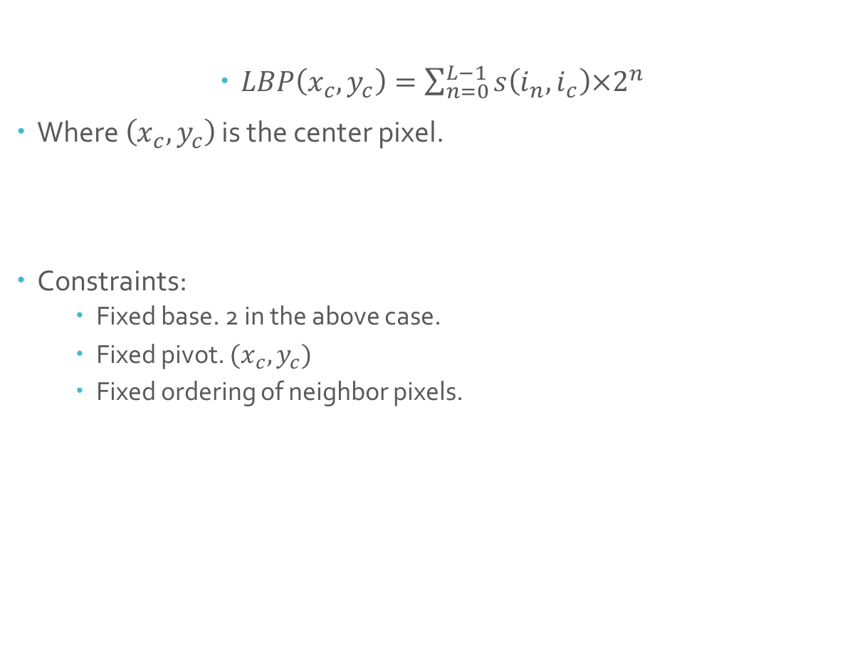
Background Knowledge
$LBP\left(x_{c}, y_{c}\right)=\sum_{n=0}^{L−1}{s\left(i_{n}, i_{c}\right)×2^{n}}$
Where $\left(x_{c}, y_{c}\right)$ is the center pixel.
Constraints:
Fixed base. 2 in the above case.
Fixed pivot. $(x_{c}, y_{c})$
Fixed ordering of neighbor pixels.
*pictures from tensorflow.org

Slide 9
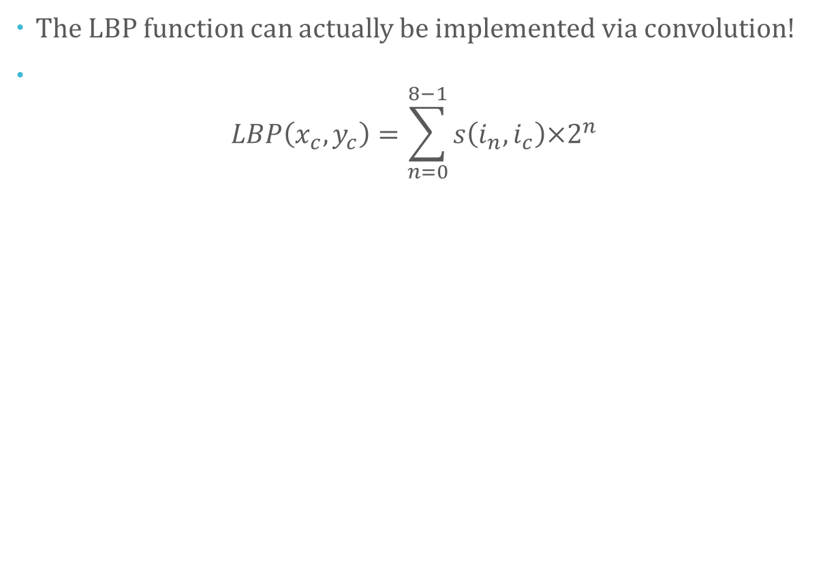
Background Knowledge
The LBP function can actually be implemented via convolution!
$LBP\left(x_{c}, y_{c}\right)=\sum_{n=0}^{8−1}{s\left(i_{n}, i_{c}\right)×2^{n}}$
*pictures from tensorflow.org

Slide 10
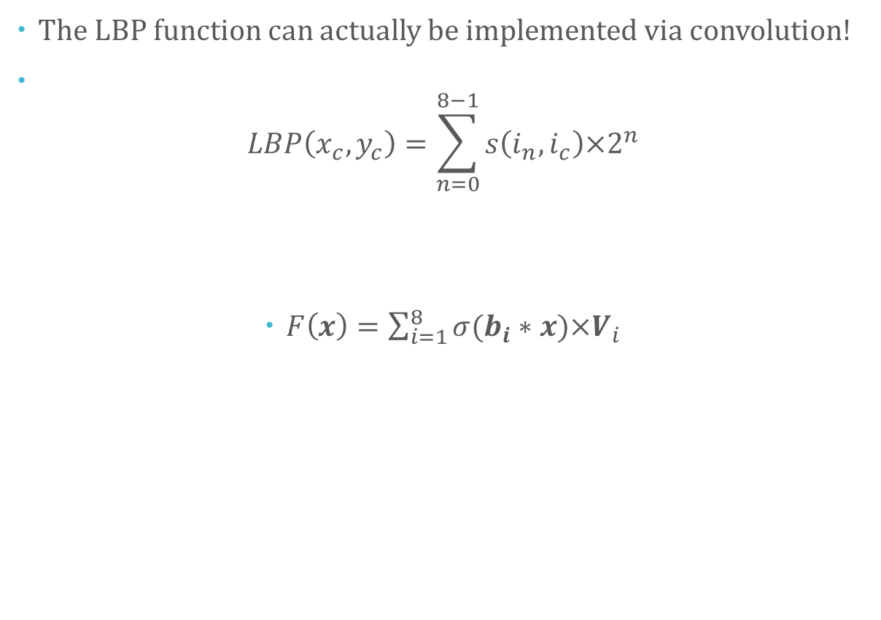
Background Knowledge
The LBP function can actually be implemented via convolution!
$LBP\left(x_{c}, y_{c}\right)=\sum_{n=0}^{8−1}{s\left(i_{n}, i_{c}\right)×2^{n}}$
$F\left(x\right)=\sum_{i=1}^{8}{σ(b_{i}∗x)×V_{i}}$
*pictures from tensorflow.org

Slide 11
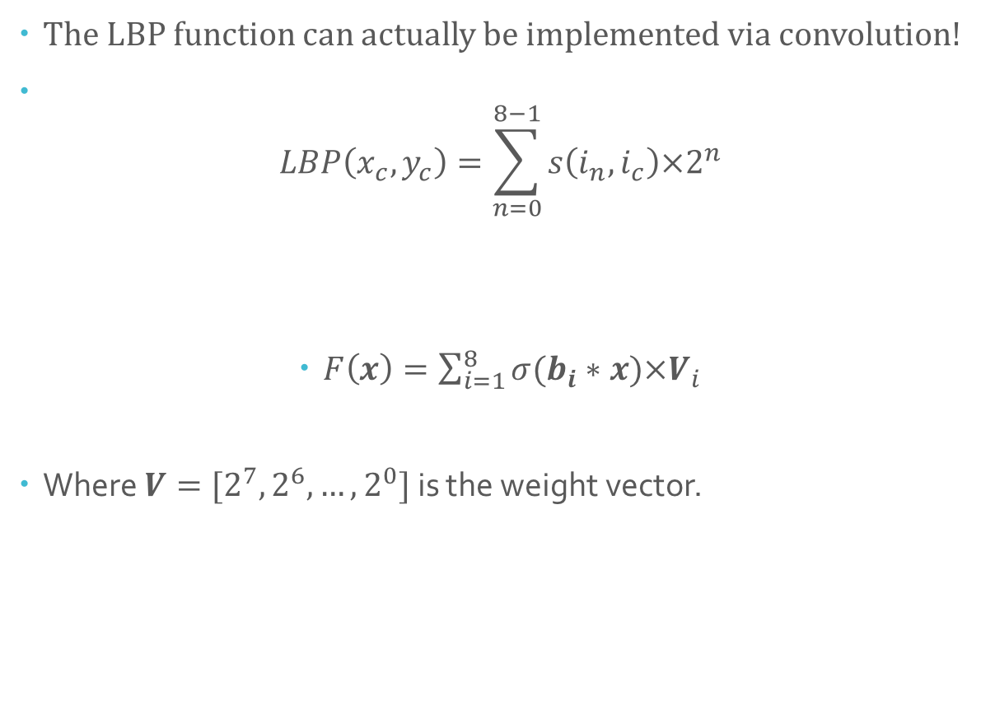
Background Knowledge
The LBP function can actually be implemented via convolution!
$LBP\left(x_{c}, y_{c}\right)=\sum_{n=0}^{8−1}{s\left(i_{n}, i_{c}\right)×2^{n}}$
$F\left(x\right)=\sum_{i=1}^{8}{σ(b_{i}∗x)×V_{i}}$
Where $V=[2^{7},2^{6},…, 2^{0}]$ is the weight vector.
*pictures from tensorflow.org

Slide 12
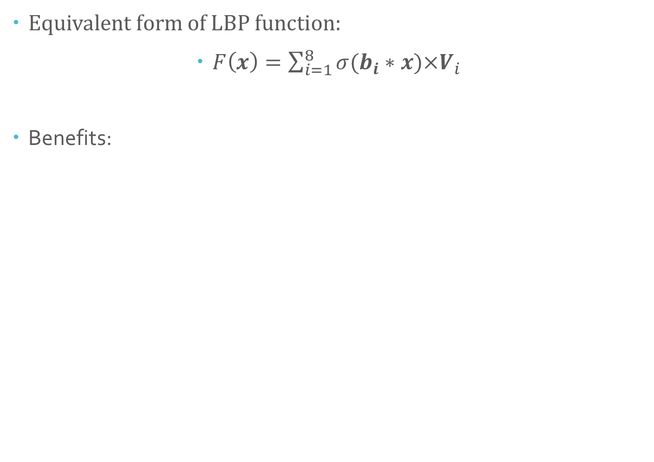
Background Knowledge
Equivalent form of LBP function:
$F\left(x\right)=\sum_{i=1}^{8}{σ(b_{i}∗x)×V_{i}}$
Benefits:
*pictures from tensorflow.org

Slide 13
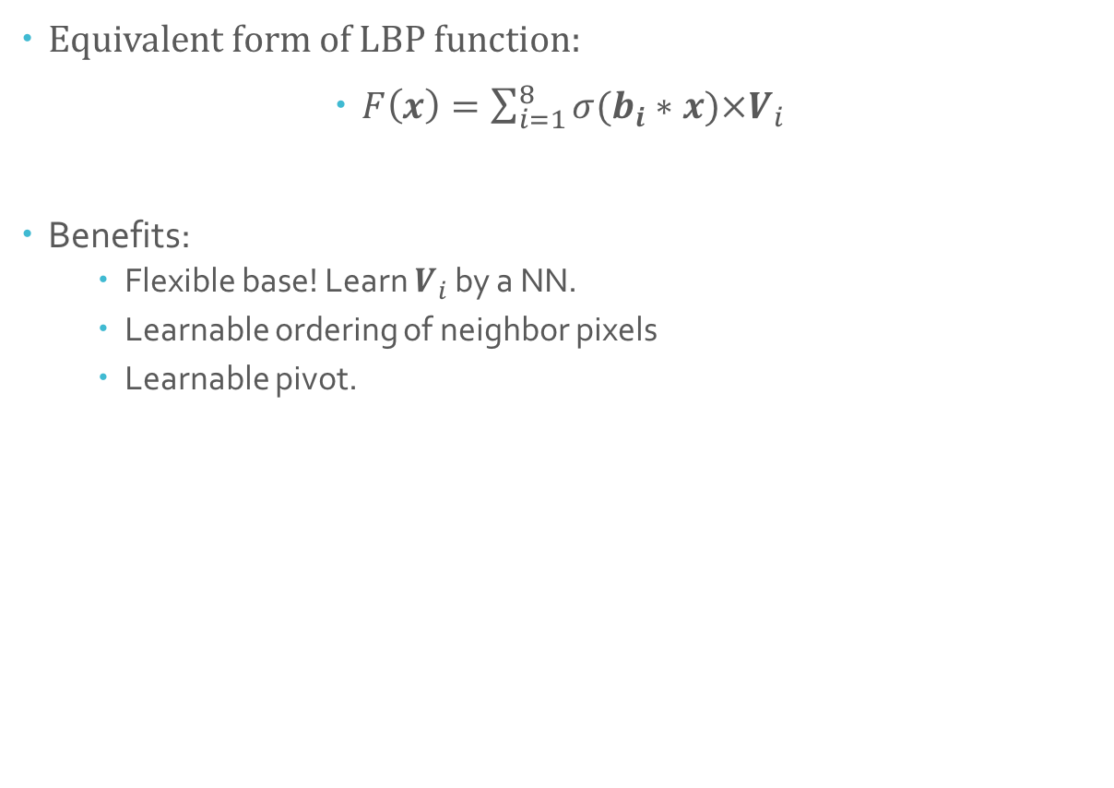
Background Knowledge
Equivalent form of LBP function:
$F\left(x\right)=\sum_{i=1}^{8}{σ(b_{i}∗x)×V_{i}}$
Benefits:
Flexible base! Learn $V_{i}$ by a NN.
Learnable ordering of neighbor pixels
Learnable pivot.
*pictures from tensorflow.org

Slide 14
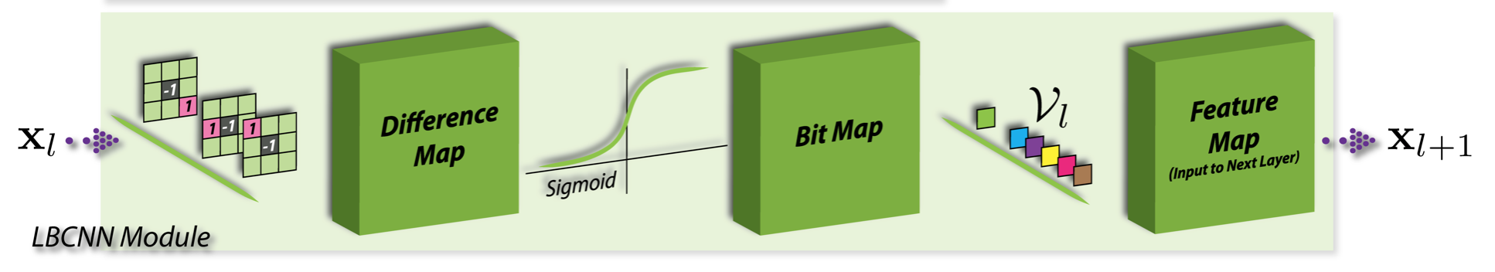
Background Knowledge
Equivalent form of LBP function:
$F\left(x\right)=\sum_{i=1}^{8}{σ(b_{i}∗x)×V_{i}}$
Benefits:
Flexible base! Learn $V_{i}$ by a NN.
Learnable ordering of neighbor pixels
Learnable pivot.
*pictures from tensorflow.org

Slide 15
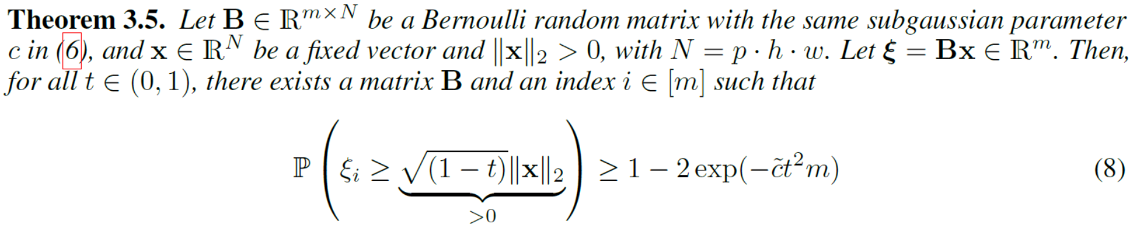
Theoretical guarantee of LBC module

Slide 16
Theoretical guarantee of LBC module
Conclusion:
LBC module is a good approximation of Convolution layer in NN

Slide 17
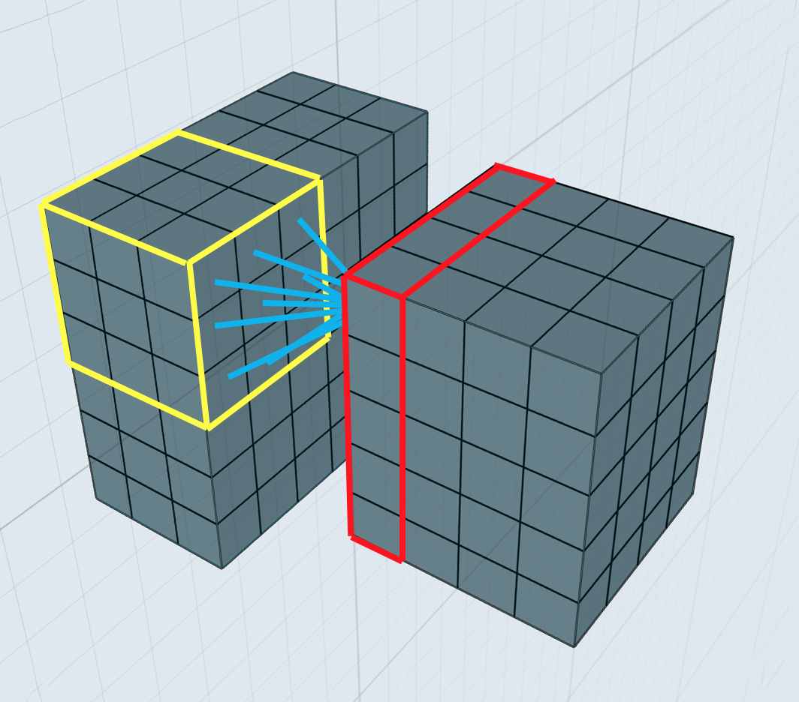
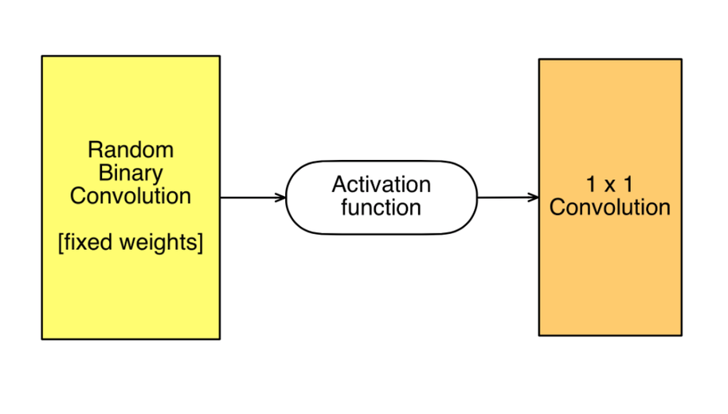
Reduction in Number of learnable weights

Slide 18
Reduction in Number of learnable weights
Input: p-channel tensor
Filter size: kH * kW
Number of different filters:
q [depth of next layer]
Number of Weights:
p * kH * kW * q

Slide 19
Reduction in Number of learnable weights
Input: p-channel tensor
Filter size: kH * kW
Number of different filters:
q [depth of next layer]
Number of Weights:
p * kH * kW * q

Slide 20
Reduction in Number of learnable weights
Input: p-channel tensor
Filter size: kH * kW
Number of different filters:
q [depth of next layer]
Number of Weights:
p * kH * kW * q
Input: p-channel tensor
Number of binary filters:
m
Number of Weights:
m * q

Slide 21
Reduction in Number of learnable weights
Input: p-channel tensor
Filter size: kH * kW
Number of different filters:
q [depth of next layer]
Number of Weights:
p * kH * kW * q
Input: p-channel tensor
Number of binary filters:
m
Number of Weights:
m * q

Slide 22
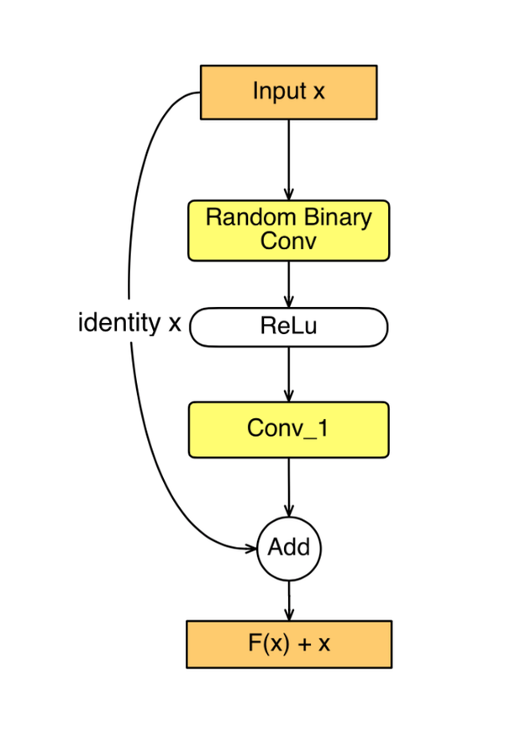
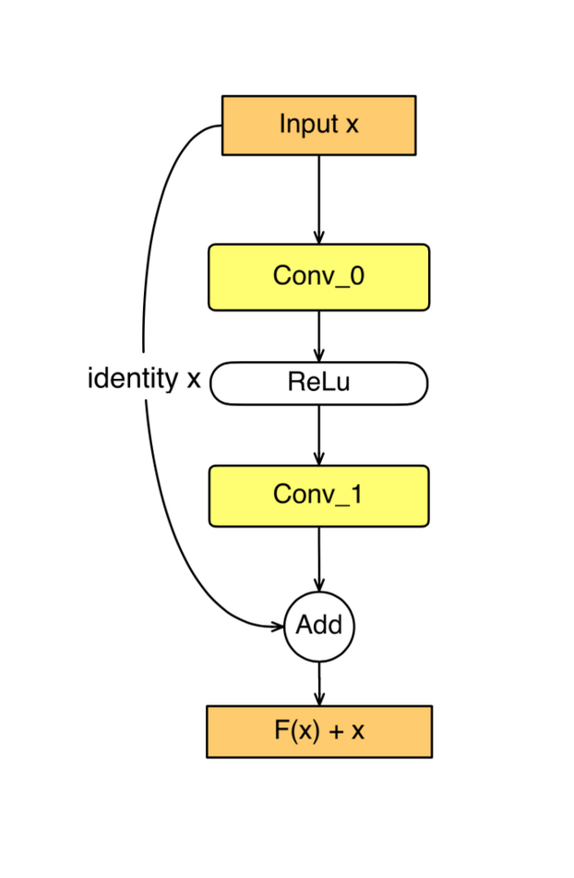
LBC Residual Block

Slide 23
LBC Residual Block

Slide 24
LBC Residual Block

Slide 25
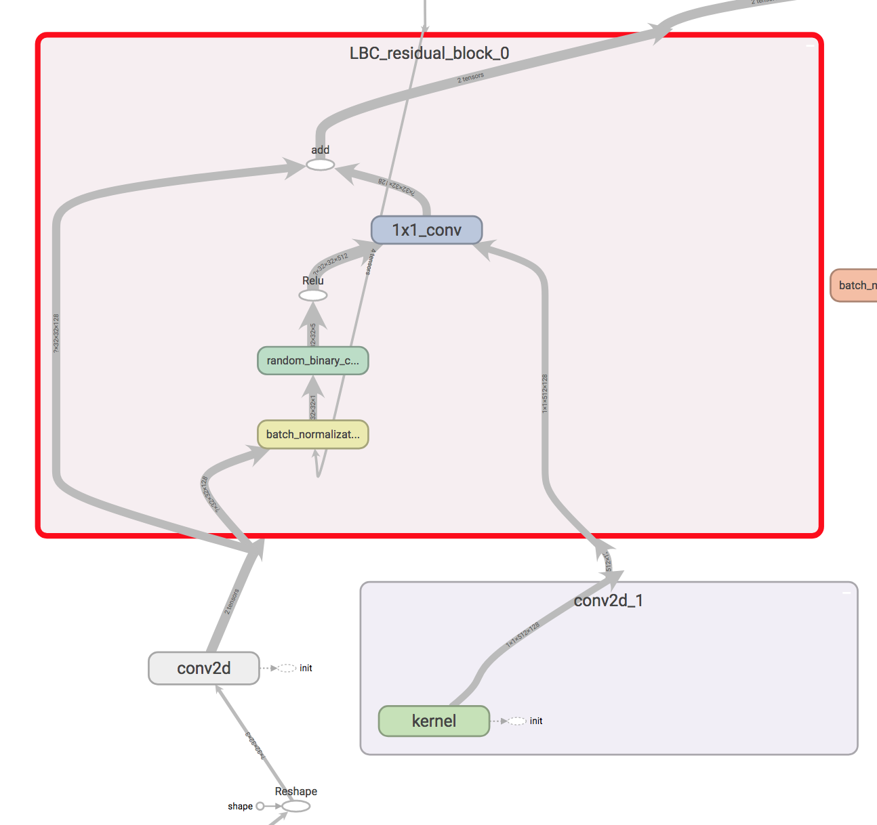
LBC Residual Block

Slide 26
LBC Residual Block

Slide 27
LBC Residual Block

Slide 28
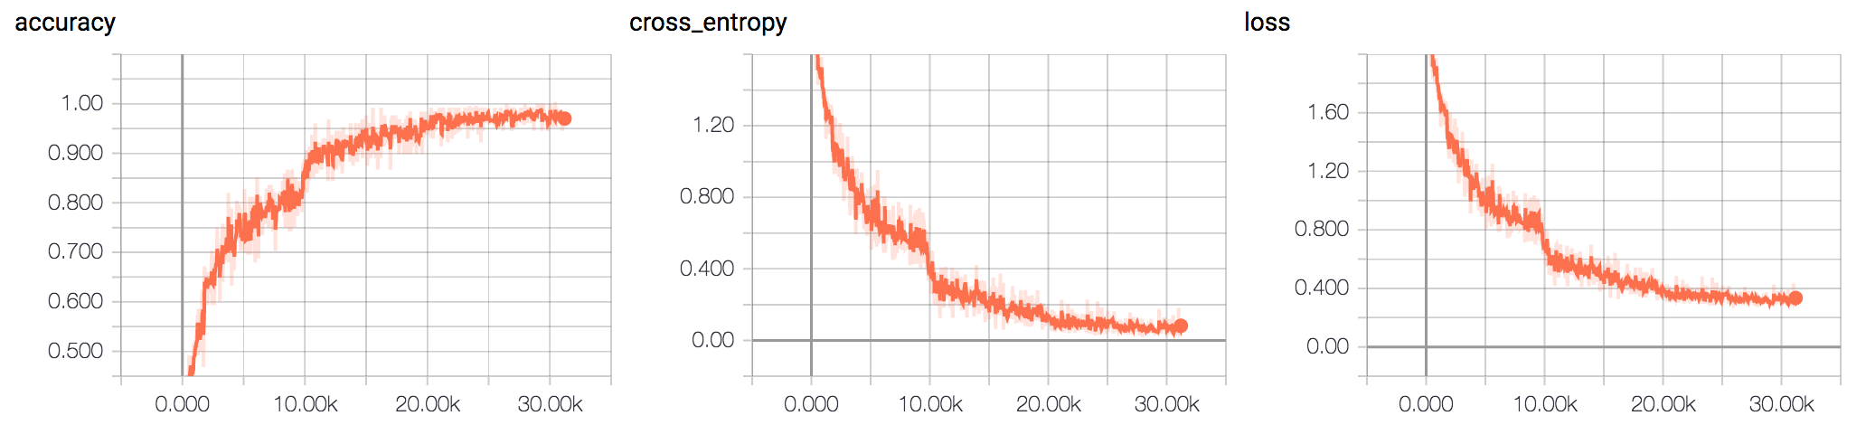
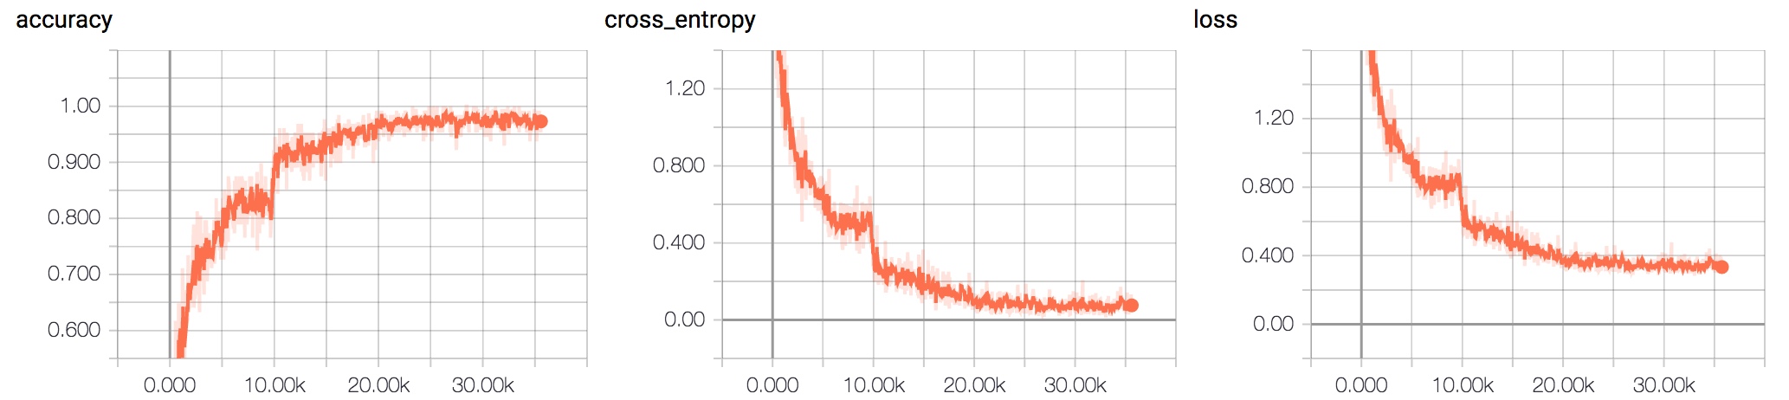
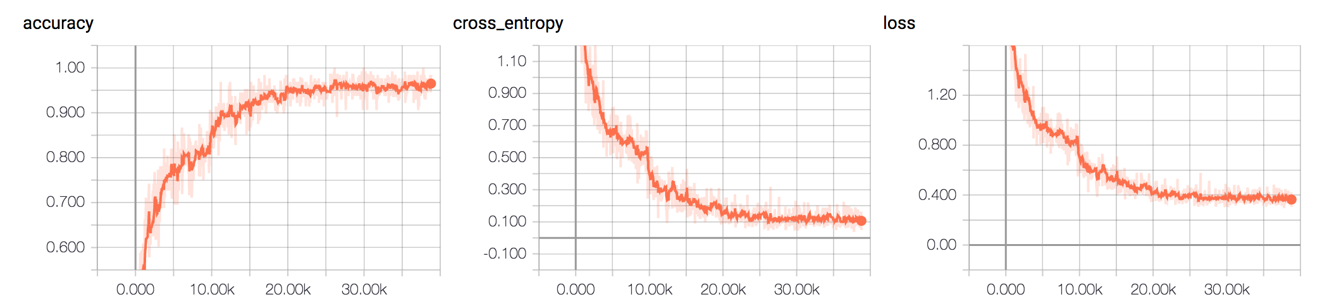
Results of LBC_ResNet on CIFAR-10 different number of binary filers
number_of_b = 512
number_of_b = 256
number_of_b = 128

Slide 29
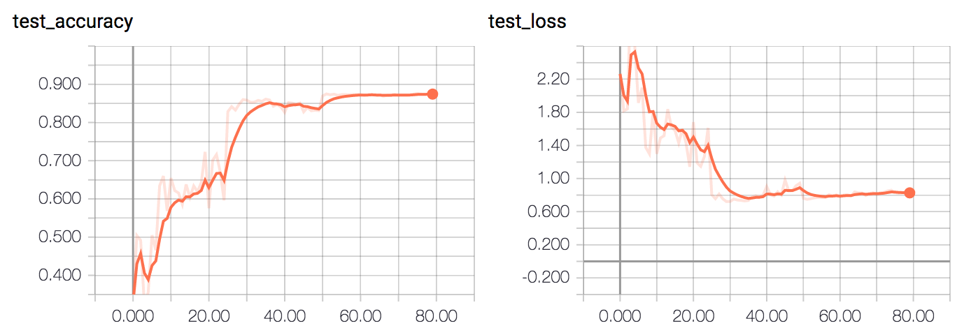
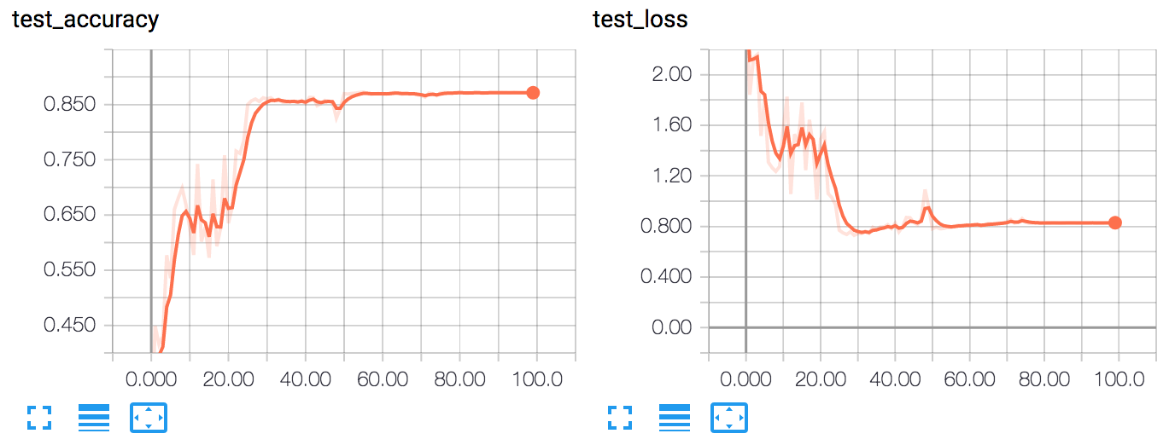
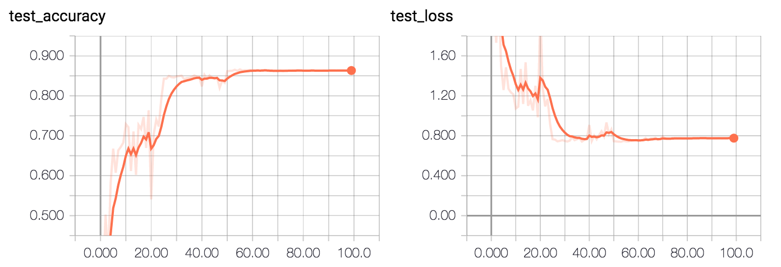
Results of LBC_ResNet on CIFAR-10 different number of binary filers
number_of_b = 256
Observation:
Increasing the number of binary filters slightly increases the test accuracy. ( ~1%)
The training procedure was not significantly affected.
Both training and test accuracy/loss saturated, but didn’t show overfitting.
In their paper, their claim to have a higher (+4% of ours) accuracy.
number_of_b = 256
number_of_b = 128

Slide 30
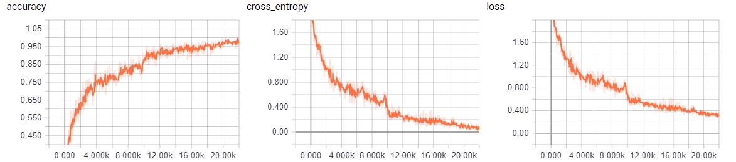
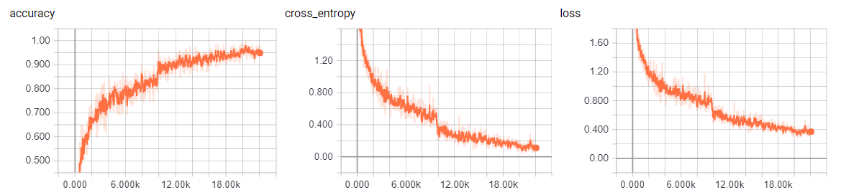
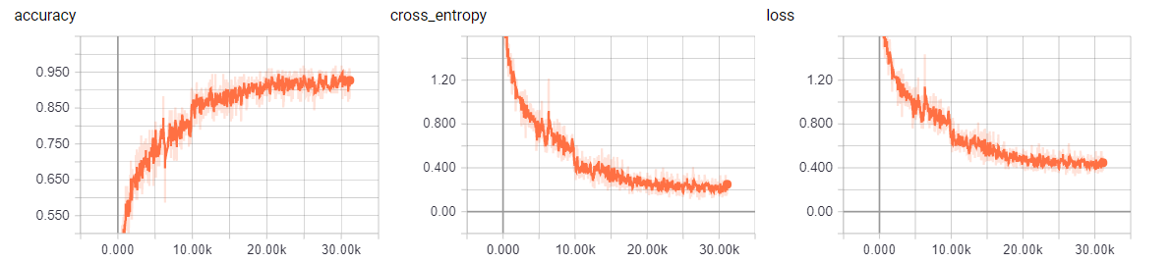
Results of LBC_ResNet on CIFAR-10 different number of depth
Depth = 15
Depth = 10
Depth = 5

Slide 31
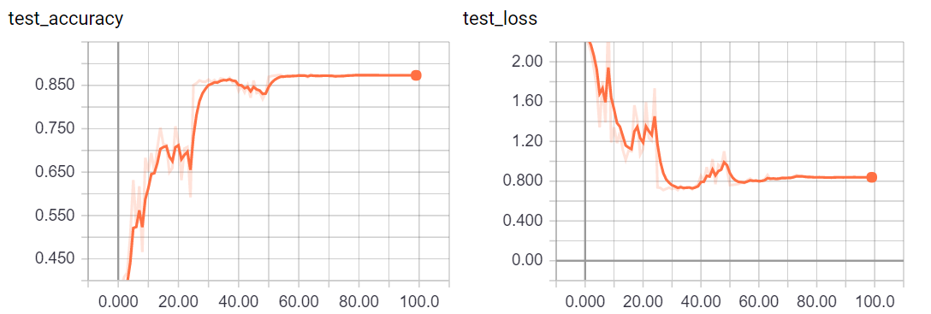
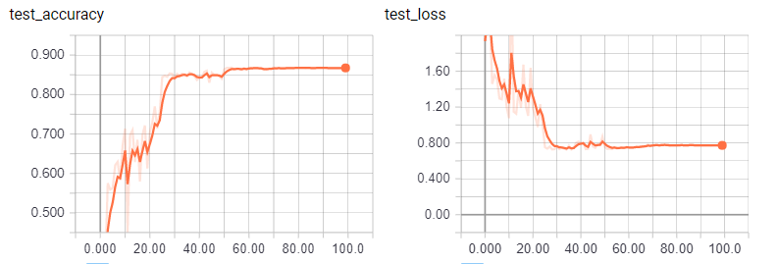
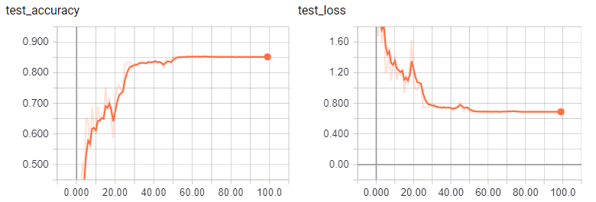
Results of LBC_ResNet on CIFAR-10 different number of depth
Depth = 15
Observation:
The deeper the better.
Overfitting does not occur
Depth = 10
Depth = 5

Slide 32
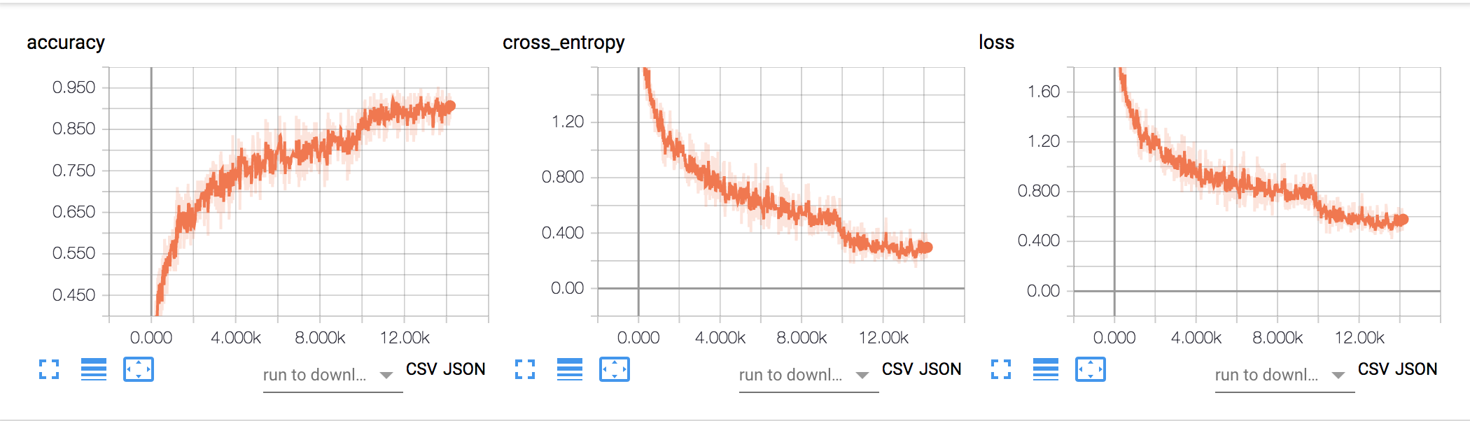
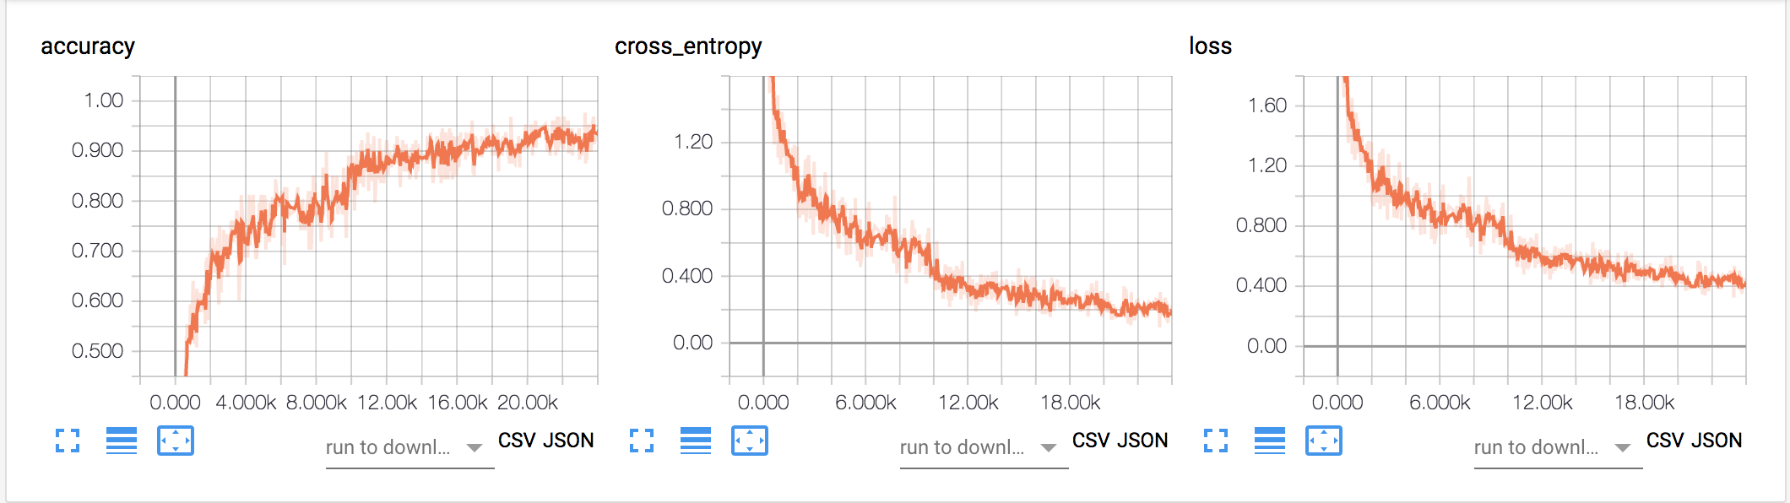
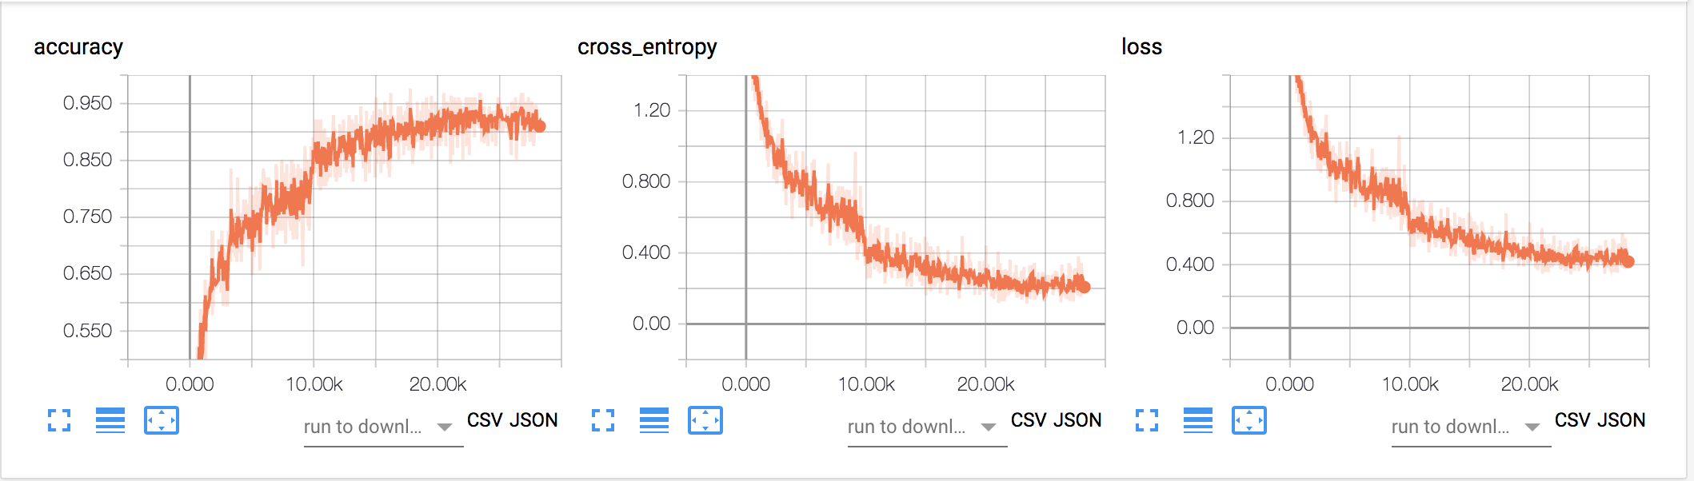
Results of LBC_ResNet on CIFAR-10 different sparsity
Sparsity = 0.5
Sparsity = 0.3
Sparsity = 0.1

Slide 33
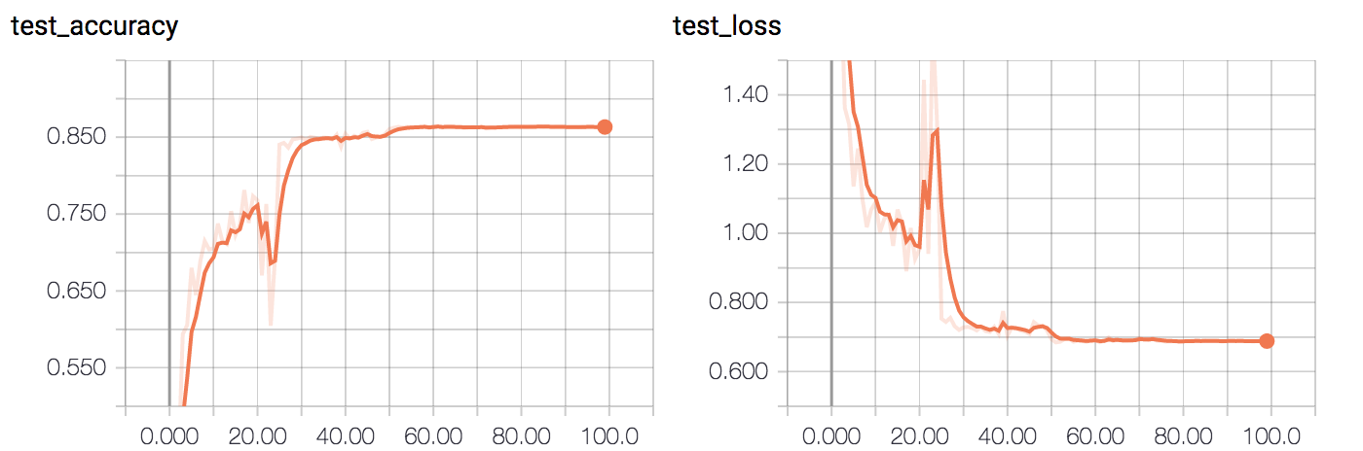
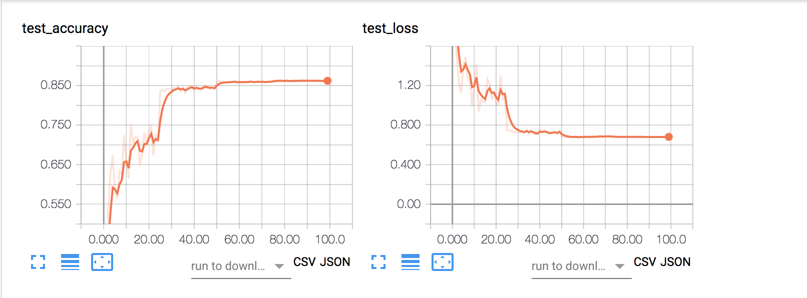
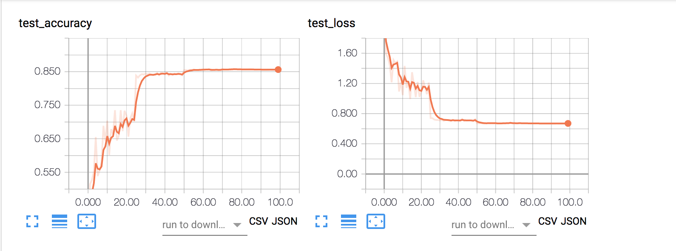
Results of LBC_ResNet on CIFAR-10 different sparsity
Sparsity = 0.5
Observation:
Accuracy leap happens at almost the same training step.
No significant accuracy/loss difference with various sparsity.
Sparsity = 0.3
Sparsity = 0.1

Slide 34
Future Works
1. Fine tuning the learning rate, and hopefully the model can keep searching the optimum.
2. Try using the shared weight configuration in the paper, to see how this help with training/model size.
3. It still have time, test on other dataset to verify our observation and speculation

Slide 35
The End
Thank you!

